Slide 1
Software Construction
Department of Computer Science
Quaid-i-Azam University
Fall 2023 Semester
Course Instructor: Onaiza Maqbool
Notes:
‹#›

Slide 2
Software
Software is
instructions (computer programs) that when executed provide desired function and performance
data structures that enable the programs to adequately manipulate information
descriptive information in both hard copy and virtual forms that describes the operation and use of the programs
‹#›
Adapted from
Software Engineering A Practitioner’s Approach by R.S. Pressman
& Software Engineering A lifecycle approach by P. Mohapatra

Slide 3
Software Process
Process
a series of steps involving activities, constraints, and resources that produce an intended output of some kind (software)
Involves a set of tools and techniques
Good processes
lead to good software
enhance visibility
reduce risks
A number of process steps that must be part of all software projects
‹#›
Adapted from
Software Engineering A Practitioner’s Approach by R.S. Pressman
& Software Engineering A lifecycle approach by P. Mohapatra

Slide 4
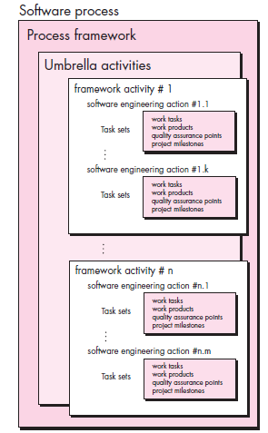

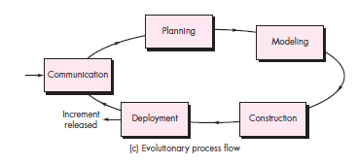
A Process Framework
‹#›
Adapted from
Software Engineering A Practitioner’s Approach by R.S. Pressman
& Software Engineering A lifecycle approach by P. Mohapatra

Slide 5
Framework Activities
Communication
Planning
Modeling
Analysis of requirements
Design
Construction
Code generation
Testing
Deployment
‹#›
Adapted from
Software Engineering A Practitioner’s Approach by R.S. Pressman
& Software Engineering A lifecycle approach by P. Mohapatra

Slide 6
Another View
Problem definition
Requirements development
Construction planning
Software architecture, or high-level design
Detailed design
Coding and debugging
Unit testing
Integration
Integration testing
System testing
Corrective maintenance
‹#›
Adapted from
Software Engineering A Practitioner’s Approach by R.S. Pressman
& Software Engineering A lifecycle approach by P. Mohapatra

Slide 7
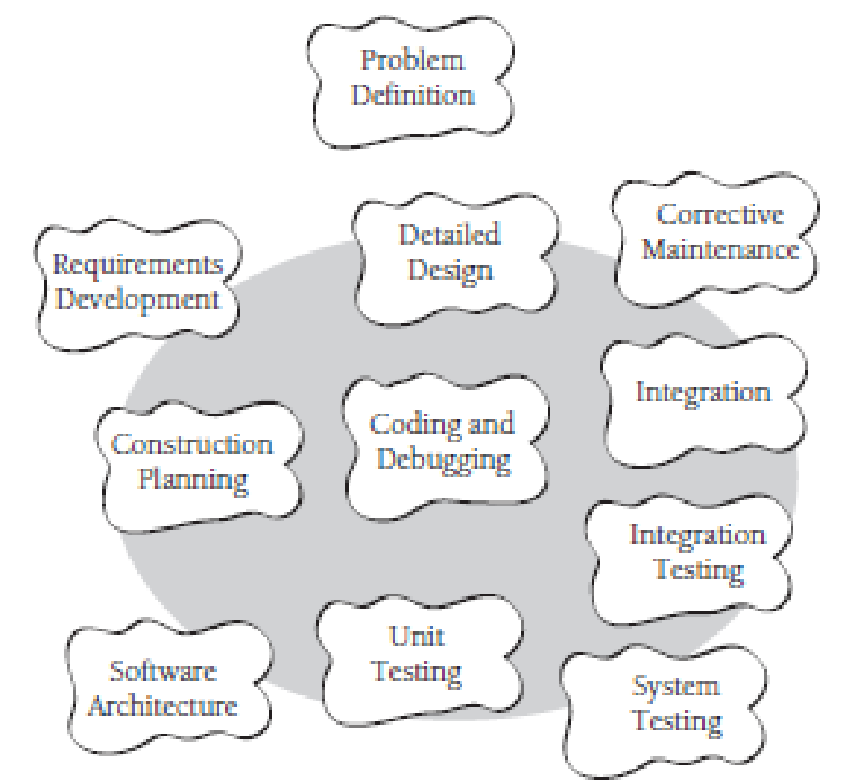
Software Construction
‹#›
Adapted from
Software Engineering A Practitioner’s Approach by R.S. Pressman
& Software Engineering A lifecycle approach by P. Mohapatra
Lecture1

Slide 8
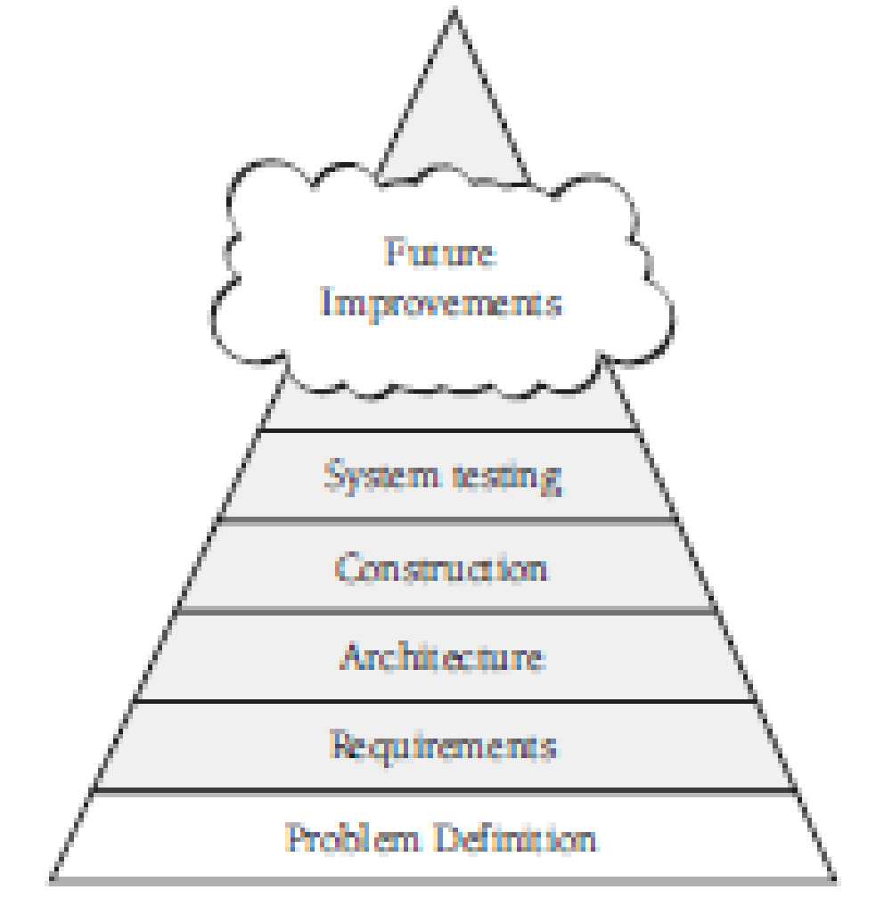
‹#›
Adapted from
Software Engineering A Practitioner’s Approach by R.S. Pressman
& Software Engineering A lifecycle approach by P. Mohapatra
Lecture1

Slide 9
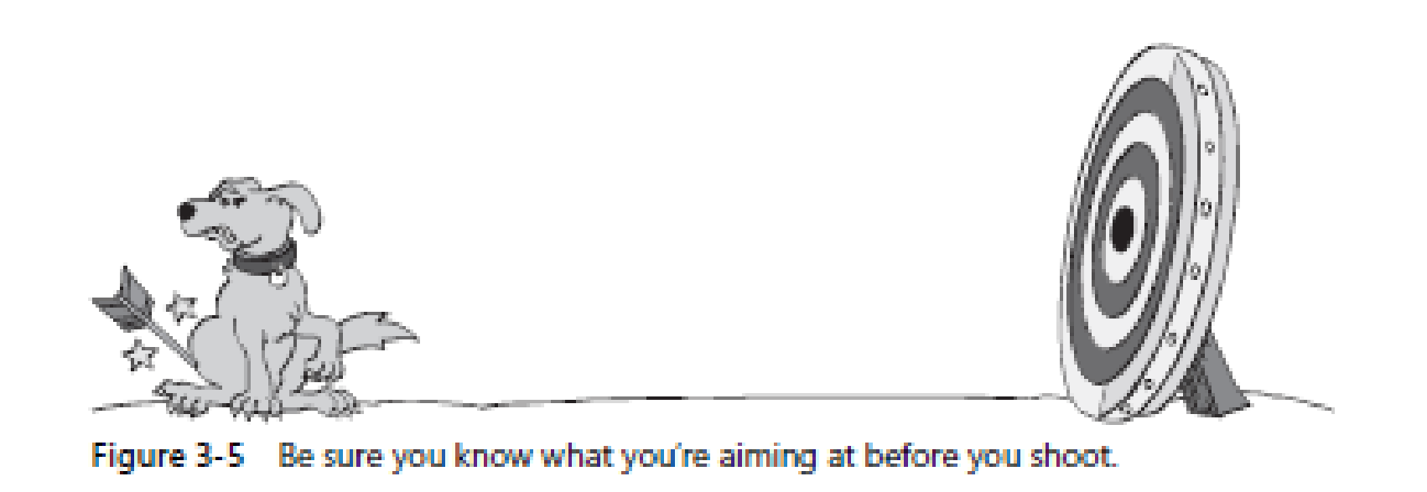
‹#›
Adapted from
Software Engineering A Practitioner’s Approach by R.S. Pressman
& Software Engineering A lifecycle approach by P. Mohapatra
Lecture1

Slide 10
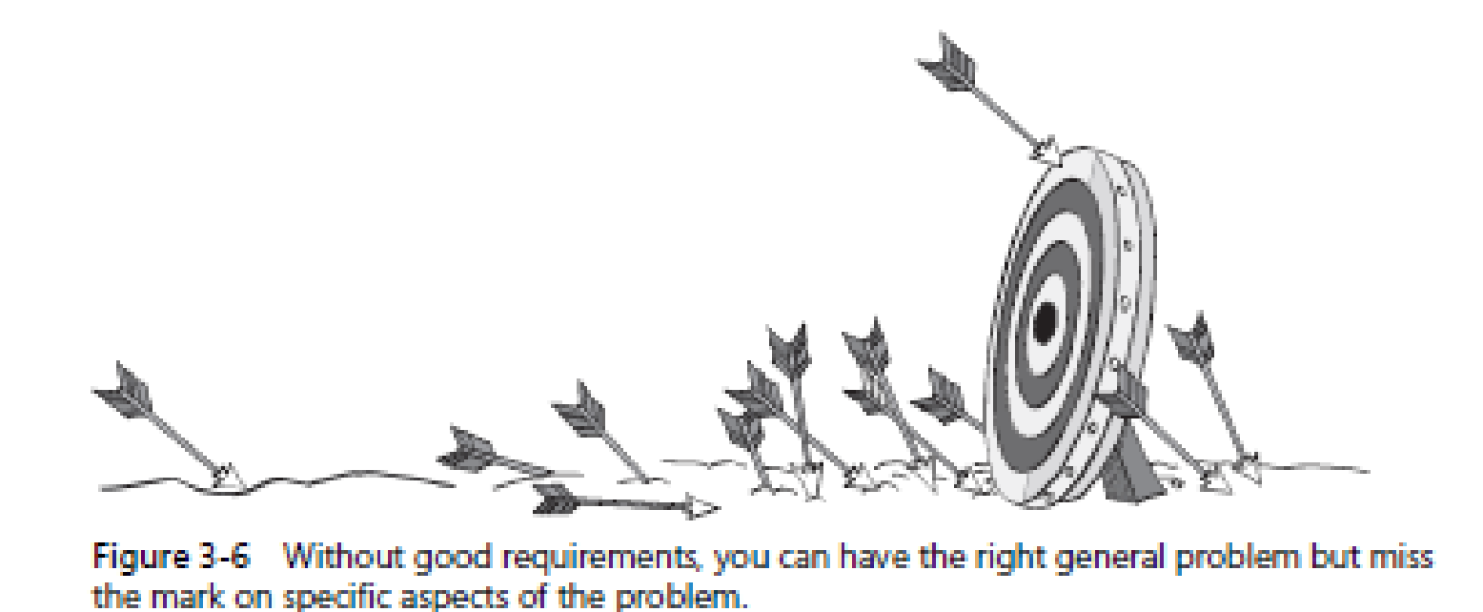
Importance of requirements
‹#›
Adapted from
Software Engineering A Practitioner’s Approach by R.S. Pressman
& Software Engineering A lifecycle approach by P. Mohapatra
Lecture1

Slide 11
Importance of Software Construction
Construction is a large part of software development
Construction is the central activity in software development
With a focus on construction, the individual programmer’s productivity can improve enormously
Construction’s product, the source code, is often the only accurate description of the software
Construction is the only activity that’s guaranteed to be done
‹#›
Adapted from
Software Engineering A Practitioner’s Approach by R.S. Pressman
& Software Engineering A lifecycle approach by P. Mohapatra
Lecture1

Slide 12
Umbrella Activities
Software project management
Formal technical reviews
Software quality assurance
Software configuration management
Work product preparation and production
Reusability management
Measurement
Risk management
‹#›
Adapted from
Software Engineering A Practitioner’s Approach by R.S. Pressman
& Software Engineering A lifecycle approach by P. Mohapatra

Slide 13
Generic Activities of Software Development
Phases | Activities | Work Products
Definition (The Problem) | System Engineering
 | Project Planning | Project Plan
 | Requirement Analysis | Requirement Specification Acceptance Test Specification
Development (The Solution) | Software Design | Design Specification Test Specification
 | Coding | Code User Manual
 | Testing | Test Report
Support | Installation
 | Maintenance | Maintenance Report
‹#›
Adapted from
Software Engineering A Practitioner’s Approach by R.S. Pressman
& Software Engineering A lifecycle approach by P. Mohapatra

Slide 14
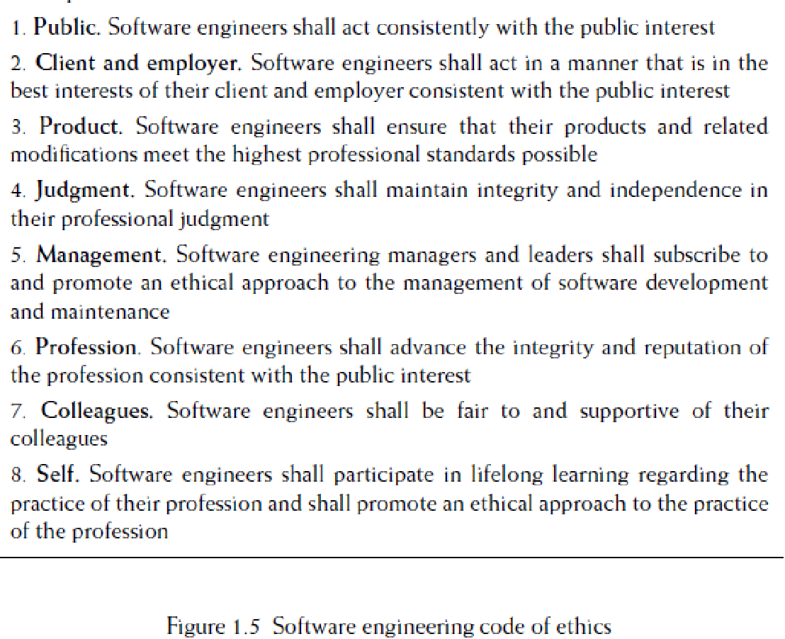
Software Engineering Code of Ethics
‹#›
https://ethics.acm.org/code-of-ethics/software-engineering-code/
Adapted from
Software Engineering A Practitioner’s Approach by R.S. Pressman
& Software Engineering A lifecycle approach by P. Mohapatra
Lecture1

Slide 15
Course outline
Aims:
To enable students to adopt a disciplined approach to software construction.
To equip students with the skills to practically carry out important phases of a software development project by working on a case study.
To familiarize students with the deliverables associated with the phases with emphasis on documentation and quality.
To enable students to deliver a working system, developed according to the specified requirements, and following good design principles.
‹#›
Adapted from
Software Engineering A Practitioner’s Approach by R.S. Pressman
& Software Engineering A lifecycle approach by P. Mohapatra

Slide 16
Course Learning Outcomes
Explain the concepts & activities in the entire software engineering process focusing on construction and major umbrella activities | C2 | PLO2
2. Develop work products for software development activities | C3 | PLO4
3. Develop a software system according to the developed analysis and design models for a given set of requirements, test and evaluate it | C5 | PLO5
4. Analyze a design/compare designs for good design principles | C4 | PLO4
5. Work effectively as a team member/leader to design and implement a software system and defend design/implementation decisions | C5 | PLO6

Slide 17
Course outline (contd…)
Week | Lecture | Readings
1 | Introduction to software development phases, project planning, Introduction to projects and allocation
 | Planning
2 | Development of the project plan, review
 | Analysis
3 | Defining usecases
4 | Development of analysis models
5 | SRS development, review and refinement
 | Design
6 | Design principles, data design
7 | Interface design/Mid term
‹#›
Adapted from
Software Engineering A Practitioner’s Approach by R.S. Pressman
& Software Engineering A lifecycle approach by P. Mohapatra

Slide 18
Course outline (contd…)
8 | Detailed design
9 | Review of design and refinement
 | Development
10 | Database connectivity
11 | Refining the front-end
12 | Development of classes
13 | Refinement of classes and traceability with design
 | Testing
14 | Testing of the software system
15 | Project Presentations
16 | Project Presentations
‹#›
Adapted from
Software Engineering A Practitioner’s Approach by R.S. Pressman
& Software Engineering A lifecycle approach by P. Mohapatra

Slide 19
Course outline (contd…)
Evaluation Criteria:
Final exam - 50 Marks
Mid term - 25 Marks
Planning - 02 Marks
Analysis - 03 Marks
Design - 05 Marks
Implementation & Testing - 10 Marks
Quizzes – 05 Marks
‹#›
Adapted from
Software Engineering A Practitioner’s Approach by R.S. Pressman
& Software Engineering A lifecycle approach by P. Mohapatra

Slide 20
Course outline (contd…)
Recommended Readings:
Roger S. Pressman, Software Engineering - A Practitioner's Approach, McGraw Hill, 8th Edition, 2015
Craig Larman, Applying UML and Patterns, Pearson Education, Third edition, 2005
Steve McConell, Code Complete, Microsoft Press, 2nd Edition, 2004
Ian Sommerville, Software Engineering, Addison Wesley, Tenth Edition, 2016
Pratap Mohapatra, Software Engineering A Lifecycle Approach, New Age Publications, 2010
‹#›
Adapted from
Software Engineering A Practitioner’s Approach by R.S. Pressman
& Software Engineering A lifecycle approach by P. Mohapatra
Lecture1

Slide 21
Course outline (contd…)
Policies
Late assignments may be accepted with marks reduction. There will be a 10% reduction for assignments submitted up to 24 hours late.
Students who have copied assignments or whose assignments have been copied will both be given a zero
Plagiarism is not acceptable. Anyone found to be guilty of plagiarism in an assignment will be given a zero in that assignment
Quizzes are expected to be unannounced
Failure to show up for discussion, or being late will result in deduction of marks
Website
Office Hours
TBA
‹#›
Adapted from
Software Engineering A Practitioner’s Approach by R.S. Pressman
& Software Engineering A lifecycle approach by P. Mohapatra

